Slide 1
”Any fool can write code that a computer can understand.
Good programmers write code that humans can understand.”
Martin Fowler
Notes:
Mi charla tiene como objetivo hablar de UnitTest en Xamarin.Forms, pero es indispensable que antes cuente porque creo que es fundamental contar con UnitTest

Slide 2
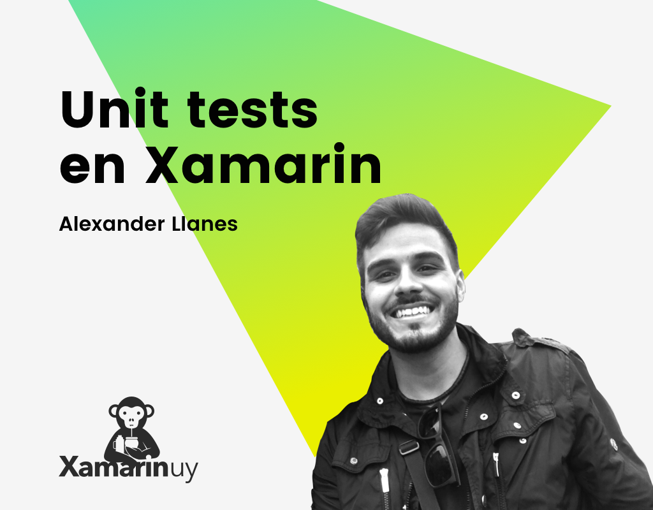








alex.llanes@gmail.com allanes87
Linkedin

Slide 3
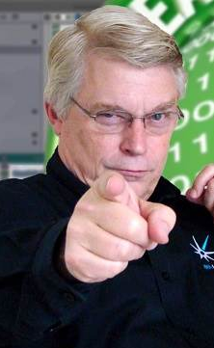
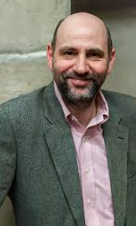
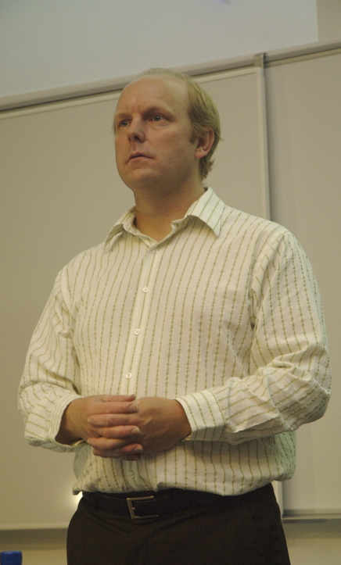
The beginning
Uncle Bob
Martin Fowler
Kent Beck
Notes:
Tengo una regla específica que intento cumplir: Si 1 persona me recomienda un libro o un lugar puede ser que lo lea o lo visite, si 2 personas me recomiendan el mismo lugar o libro investigo un poco con intención de visitar el lugar o comprar el libro. Si más de 2 personas me recomiendan el lugar o el libro, salgo a comprarlo o a visitarlo.
Uncle Bob
Clean Code
SOLID
Martin Fowler
MVVM
Dependency Injection
Kent Beck
eXtreme Programming o XP
Test-Driven Development o TDD

Slide 4
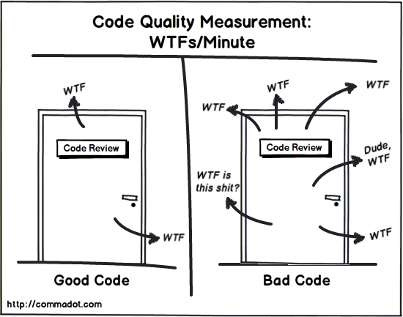
Which door represents your code?
Notes:
Cúal puerta representa tu código? el de tu equipo?
No podemos evitar todos los WTFs pero si disminuirlos de forma considerable

Slide 5
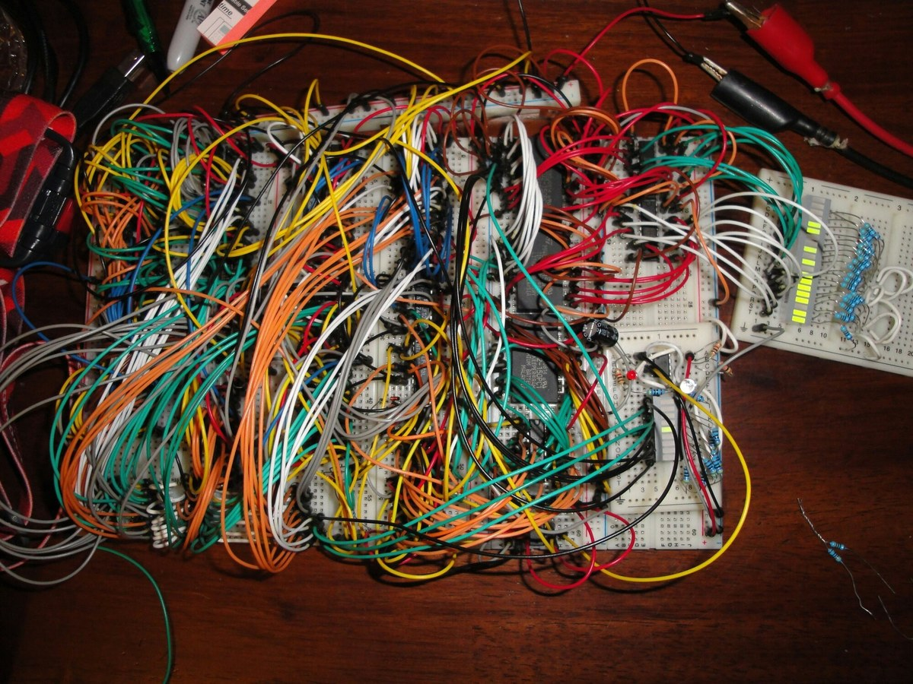
Spaghetti Code
Notes:
Quien no se encontró con este tipo de código alguna vez?
Es importante también no criticar de forma desmedida una implementación, a veces no sabemos en qué condiciones fueron llevados esos proyectos.
La frase hay que hacerlo de nuevo es una frase que casi no debería existir. A quién le gustaría entregar algo que otro equipo lo haga y diga esto hay que tirarlo y hacerlo de nuevo?

Slide 6
Clean Code is code, that is easy to understand and easy to change
Notes:
Uncle Bob, uno de los firmantes del Manifesto Agile en conjunto con Martin Fowler. Habla en varios de sus libros de un concepto llamada Clean Code
Propone responsabilizarnos como profesionales que somos y dar aviso de la calidad de nuestro código y tomar conciencia de lo que podemos hacer por mejorarlo
Nuestro código tiene que ser fácil de leer, no podemos tener miles de líneas en una clase, variables con nombres poco autodescriptivos. Cuánto tiempo invertimos en leer código de otros?
Leemos 10 veces más código del que escribimos. Indeed, the ratio of time spent reading versus writing is well over 10 to 1. We are constantly reading old code as part of the effort to write new code. ...[Therefore,] making it easy to read makes it easier to write.
When software is done right, it requires a fraction of the human resources to create
and maintain. Changes are simple and rapid. Defects are few and far between. Effort
is minimized, and functionality and flexibility are maximized

Slide 7

Boy scout rule

Slide 8
Leave your code better than you found it.
Notes:
Always leave the campground cleaner than you found it.” If you find a mess on the ground, you clean it up regardless of who might have made it. You intentionally improve the environment for the next group of campers. (Actually, the original form of that rule, written by Robert Stephenson Smyth Baden-Powell, the father of scouting, was “Try and leave this world a little better than you found it.”)

Slide 9

The Broken Windows Theory
Notes:
One broken window, left without repair for a certain amount time, consequently, will leave the impression of negligence. More windows will be broken, graffiti appears, damage in the structure appears and the sense of abandon becomes present. All it takes is just one broken window and everything can crumble.

Slide 10
Keys
Meaningful Names
Dependency inversion
DRY
Code review
Functions
SOLID
Comments
Pair programming

Slide 11
Use intention revealing names
A function shouldn’t have more than 3 arguments
function should do one thing, do it well and should do it only
20 lines per function (small functions)
Methods should have verb or verb phrase names like postPayment
Correct naming can prevent comments
Do not leave commented code
Classes and objects should have noun or noun phrase names like Customer
Don’t repeat yourself (DRY)

Slide 12
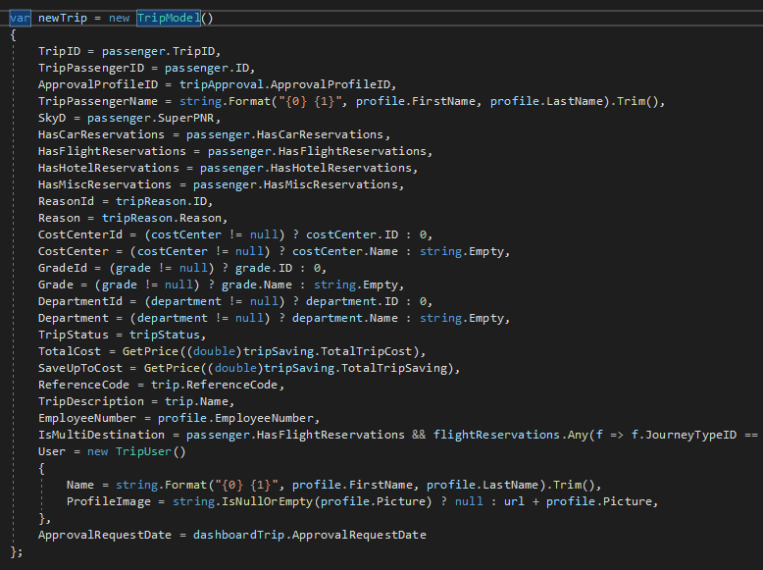
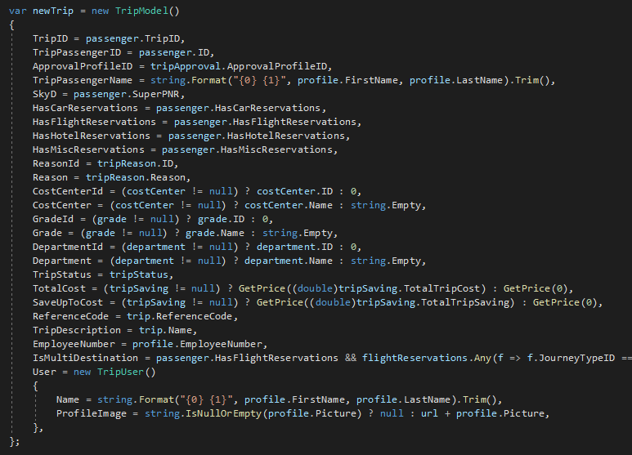
Don’t repeat yourself (DRY)
GenerateTripList
GenerateTripModel

Slide 13
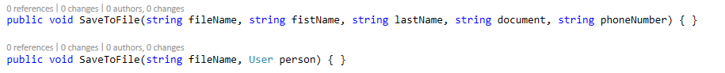
Use intention revealing names
A function shouldn’t have more than 3 arguments
int d; // elapsed time in days.
int elapsedTimeInDay;

Slide 14
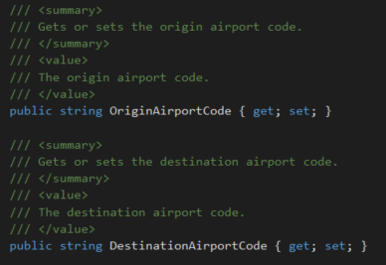
Correct naming can prevent comments

Slide 15

A Lannister always… Pays his technical debt
Notes:
Al igual que una deuda económica la deuda técnica se paga, sí la podemos aceptar por alguna fecha de entrega, pero siempre entendiendo que tarde o temprano la vamos a tener que pagar
Hay casos como los MVP o una POC en dónde es posible dejar esa deuda técnica
Mi deuda técnica la pagará otra persona o yo mismo en un tiempo

Slide 16
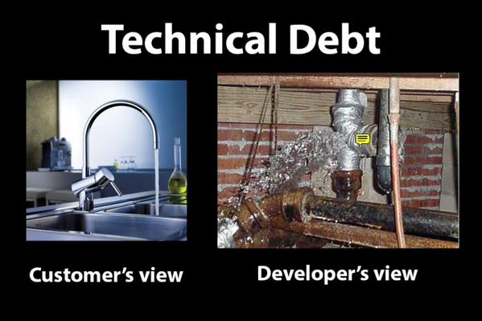

Slide 17
“Always code as if the guy who ends up maintaining your code will be a violent psychopath who knows where you live”

Slide 18
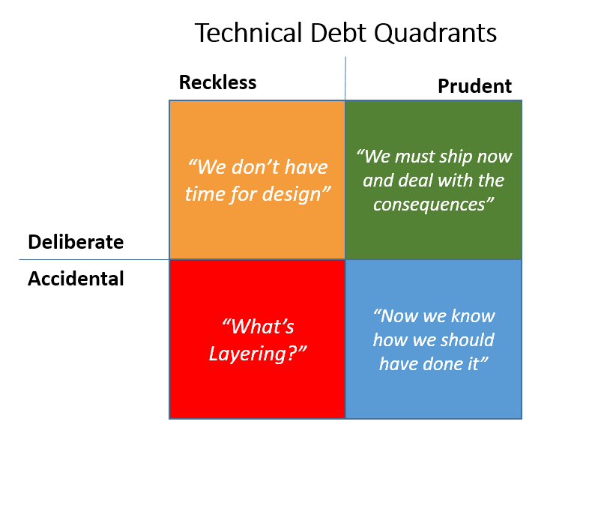
Notes:
Technical Debt Quadrant Colors
Reckless Accidental debt is the least desirable, since the team has no choice about incurring it and either doesn’t recognize it or cannot correct it once it exists. This quadrant is red, because ideally the team should stop and self-improve (through training, hiring, or whatever other means is available) such that it is able to at least recognize the kind of debt it is incurring currently. At that point, at least a rational decision can be made about whether or not it is Prudent to continue to incur it.
Reckless Deliberate debt is orange, because it is still (usually, and by definition) reckless. This kind of debt occurs when a team knows better, but consciously chooses to make “quick and dirty” updates to a system, usually in the name of speed. This kind of debt mainly applies to long term behavior, as opposed to when an actual, short-term deadline is looming, in which case it may be Prudent to incur debt.
Prudent Deliberate (green) debt represents quality shortcuts made consciously by the team because of an imminent deadline. The team recognizes the issue (and most likely adds correcting it to their backlog) and its consequences, but must choose to deliver something rather than focus on quality at this time.
Prudent Accidental technical debt is blue. It represents actual learning made by the team as work is done on a project. “Hindsight is 20/20” and frequently after completing a feature or project the team will recognize that if they had designed it differently, it might have resulted in a higher quality solution. The difference in quality between the implemented design and the ideal accounts for some accidental technical debt, because the team didn’t intentionally create it, but the team’s improved understanding of the system makes this fall into the prudent category.

Slide 19
Refactor
Notes:
Es importante hacerlo de a un paso a la vez, pequeños refactors. Luego ejecutar los test

Slide 20

fear of Refactor
Notes:
No usar UnitTest es cómo viajar sin cinturón

Slide 21
Code for humans
Apply Clean Code
Pay your debts
Pair Programming
Continuous Refactor
Code Review
UnitTest

Slide 22

Unit Test Xamarin.Forms

Slide 23
Why MVVM?
Notes:
Consultar cuantos desarrollan en Xamarin?
Cuántos utilizan MVVM?
Cuantos aplican UnitTest?

Slide 24
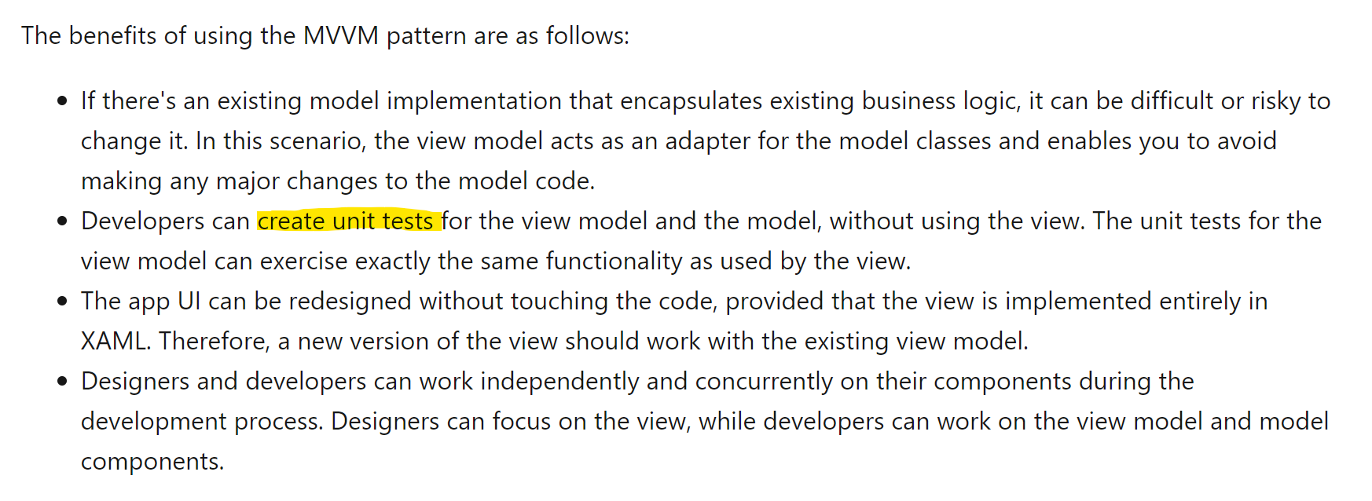
MVVM benefits

Slide 25
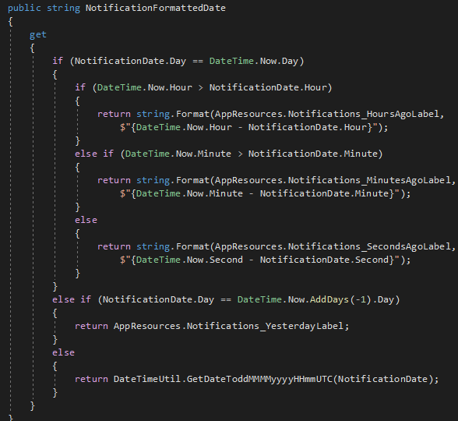
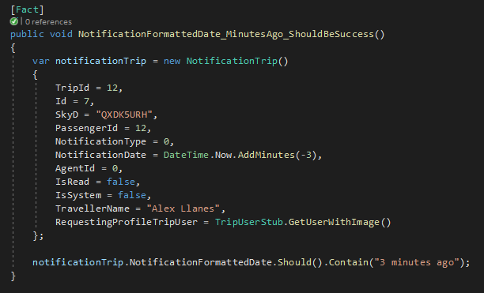
Why UnitTest?

Slide 26
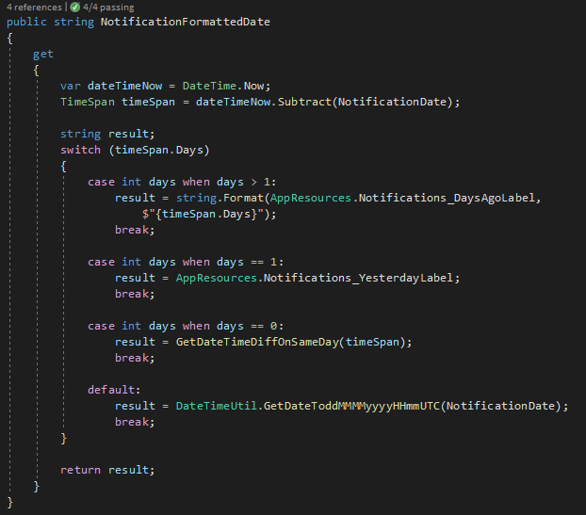
Why UnitTest?

Slide 27
Terminology
Little concepts to be on the same page

Slide 28
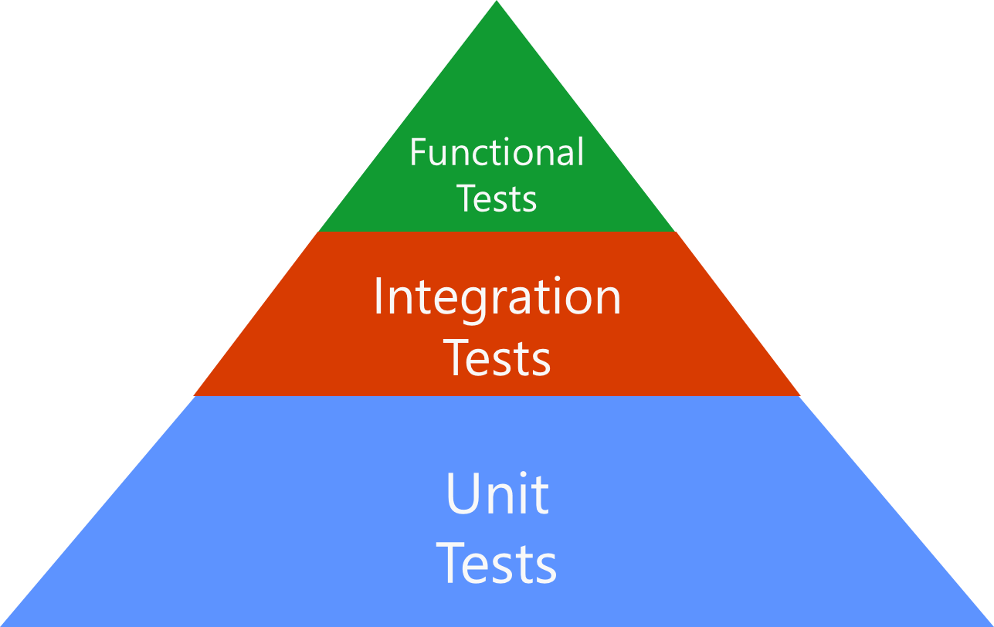
Testing Pyramid
Manual Test
Notes:
Integration Test
Integration tests tend to be slower and more difficult to set up than unit tests, because they often depend on external dependencies and infrastructure.
If you can test a given scenario with a unit test, you should test it with a unit test. If you can't, then consider using an integration test.
"Unit tests ensure you are building the thing right; functional tests ensure you are building the right thing"
Un ejemplo puede ser consumir un servicio de imagenes, podemos realizar un Test con un byte[] que sea el mock de la imagen.
Functional Test / UI Test
Functional tests are written from the perspective of the user, and verify the correctness of the system based on its requirements.
Since functional tests operate at the system level, they may require some degree of UI automation

Slide 29
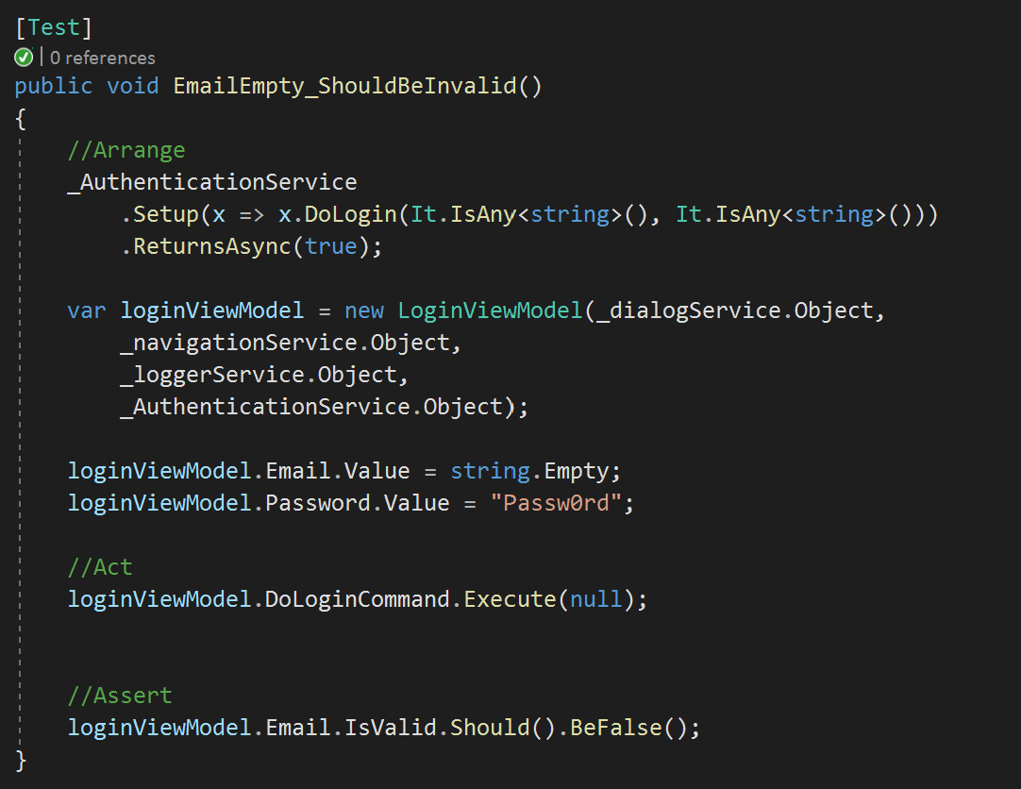
Arrange
Act
Assert
Notes:
Arrange (Organizar/Inicializa) => inicializa los objetos y establece los valores de los datos que vamos a utilizar en el Test que lo contiene.
Act (Actuar) => realiza la llamada al método a probar con los parámetros preparados para tal fin.
Assert (Confirmar/Comprobar) => comprueba que el método de pruebas ejecutado se comporta tal y como teníamos previsto que lo hiciera.

Slide 30
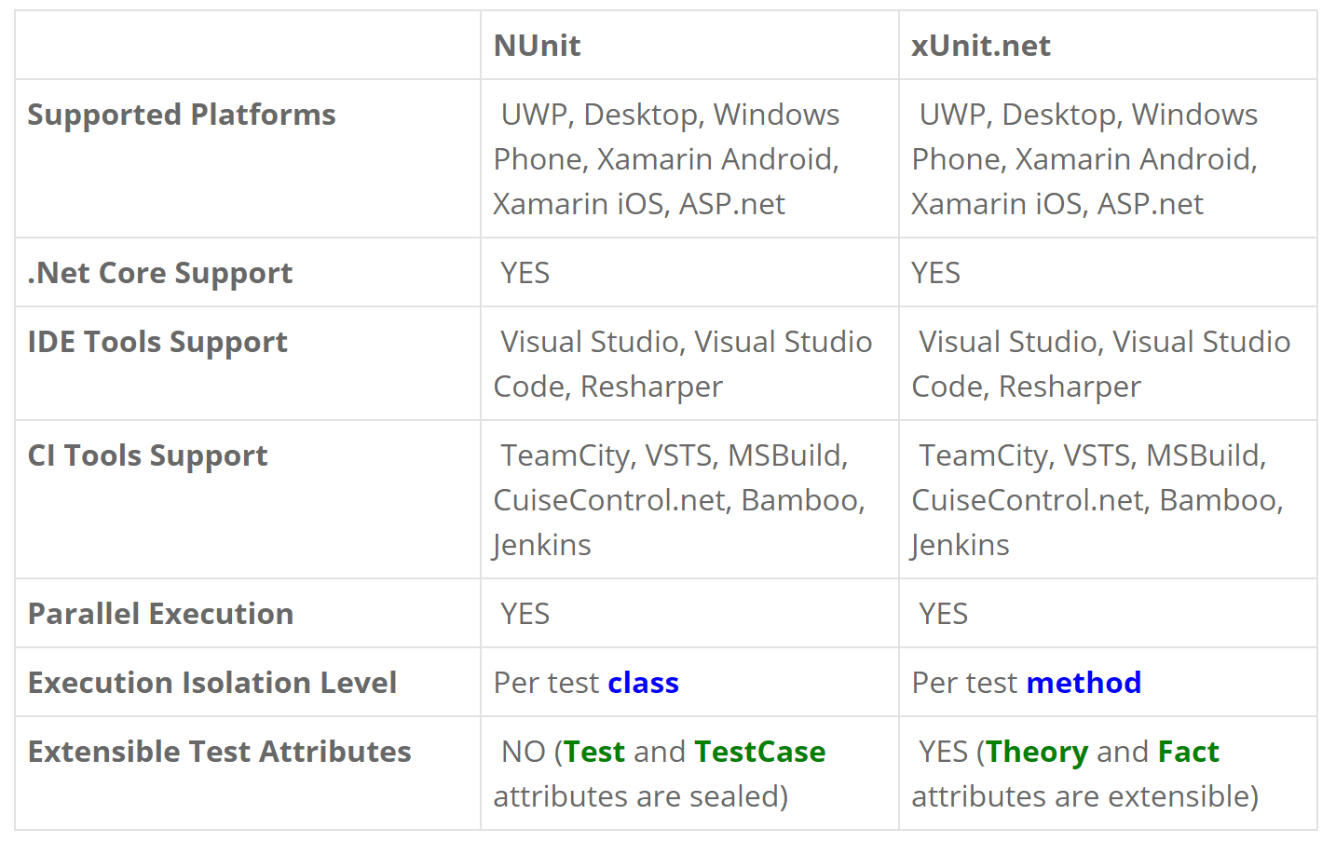
NUnit vs XUnit

Slide 31
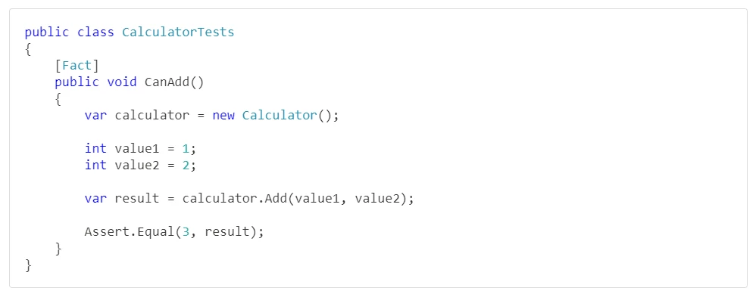
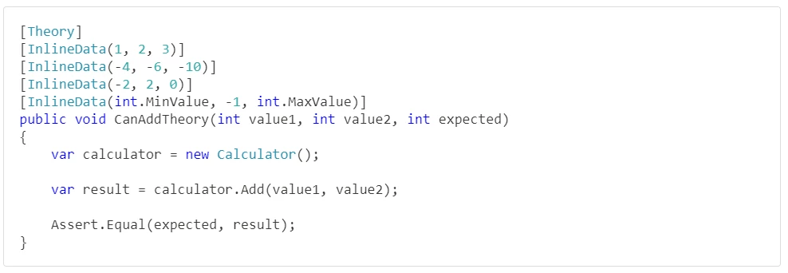
XUnit

Slide 32
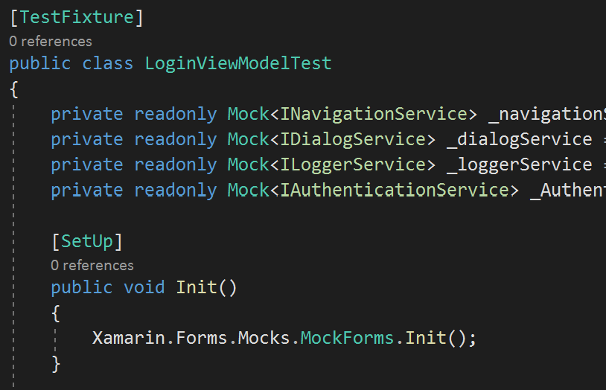
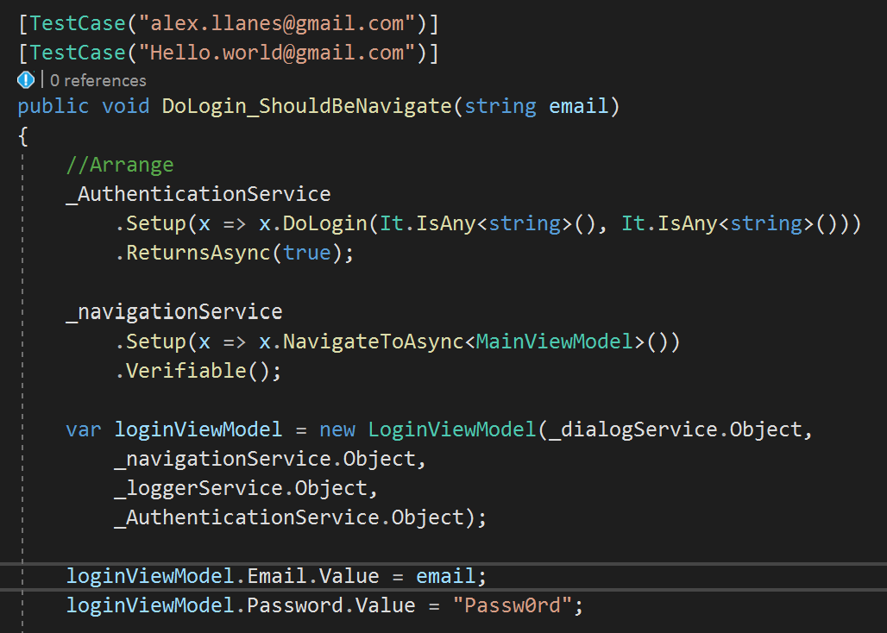
NUnit

Slide 33
Mocks
Stubs
Fake

Slide 34
Setup
Change our project to use UnitTest
Notes:
Primero tuvimos que preparar nuestro proyecto para que sea testeable

Slide 35
.NetStandard

Slide 36
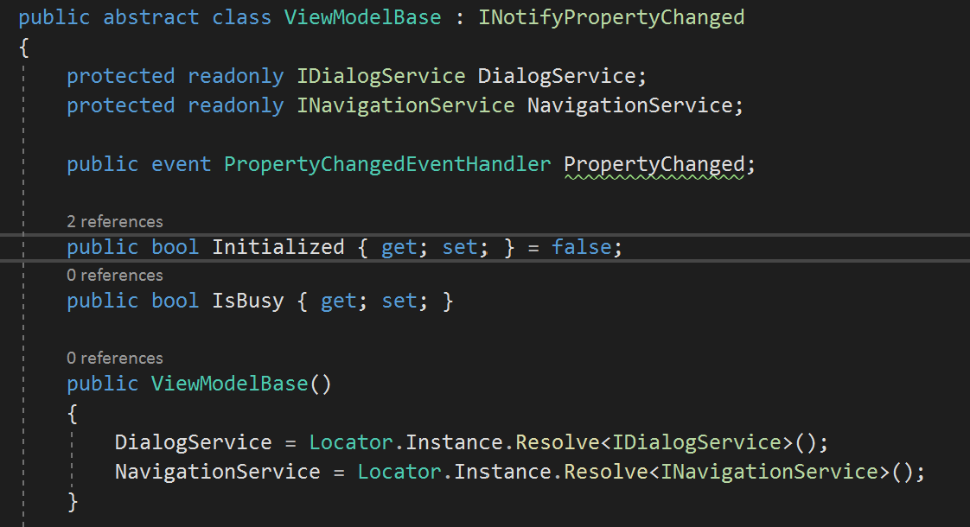
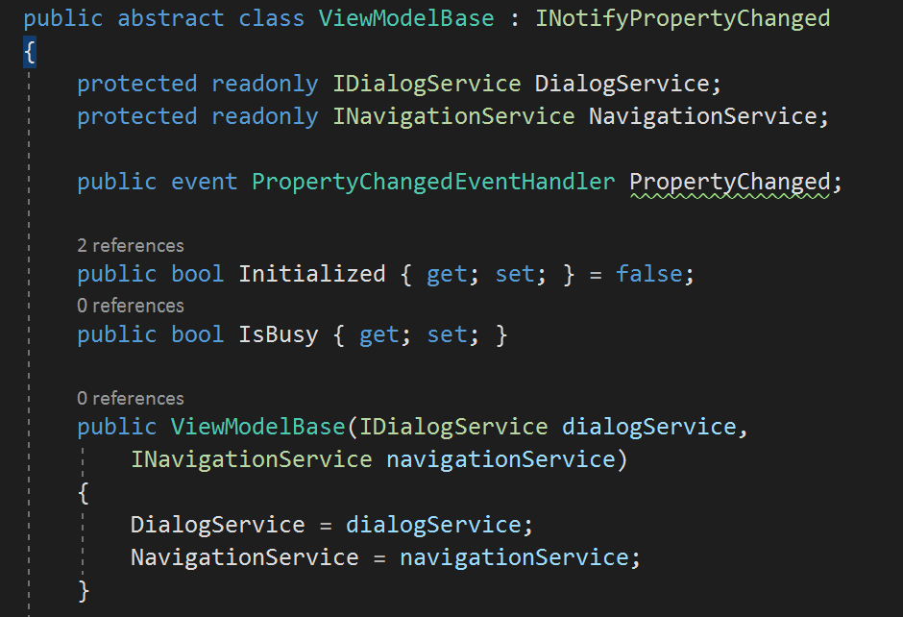
ViewModelBase
Notes:
Debemos inyectar todos los servicios

Slide 37
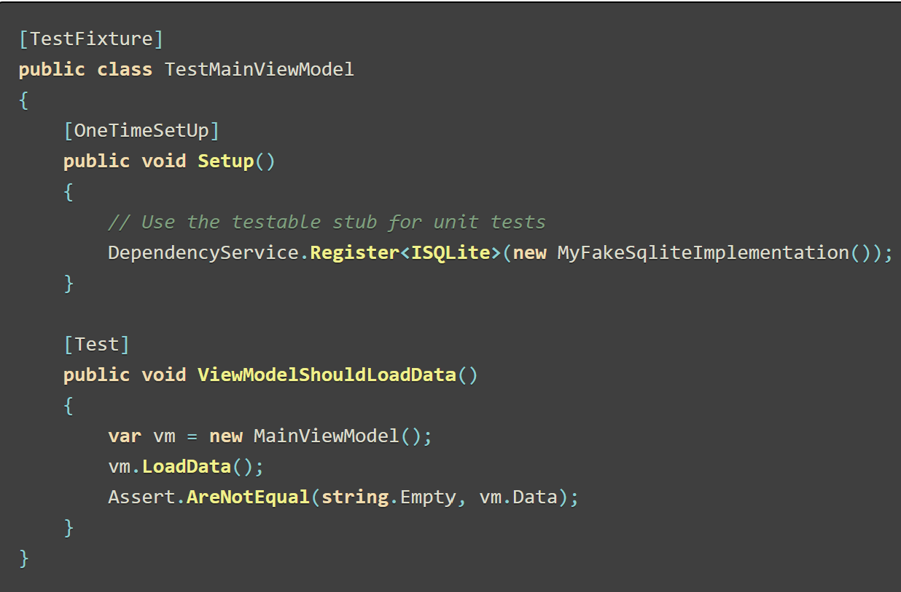
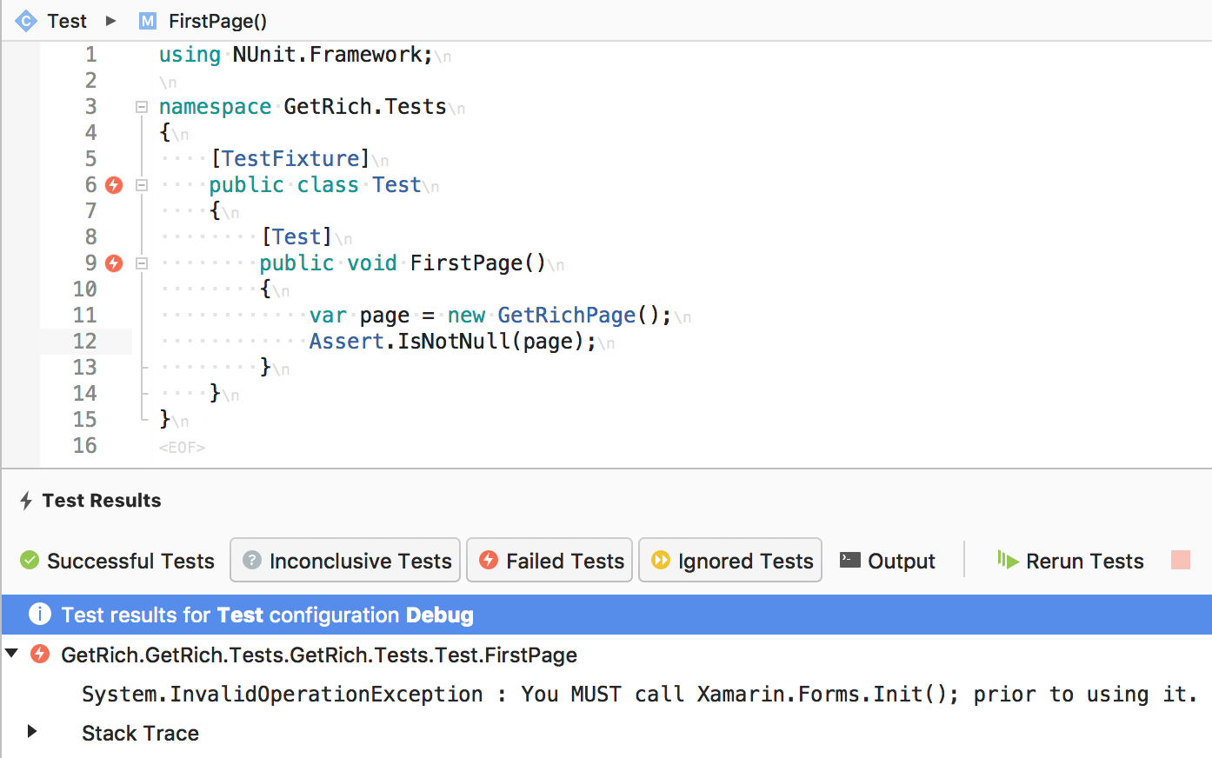
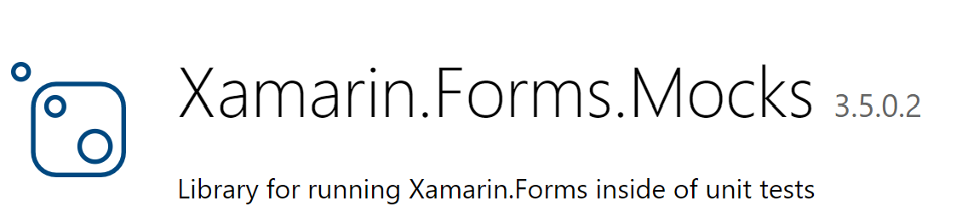
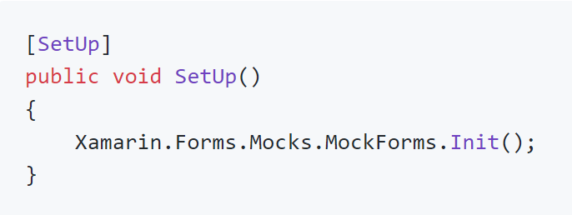
You MUST call Xamarin.Forms.Init()
Notes:
Otra es usar Xamarin.Forms.Mock

Slide 38
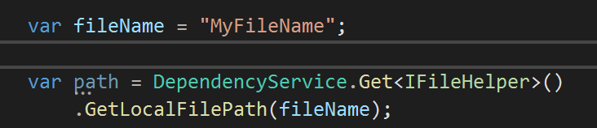
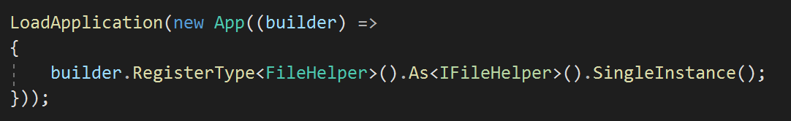
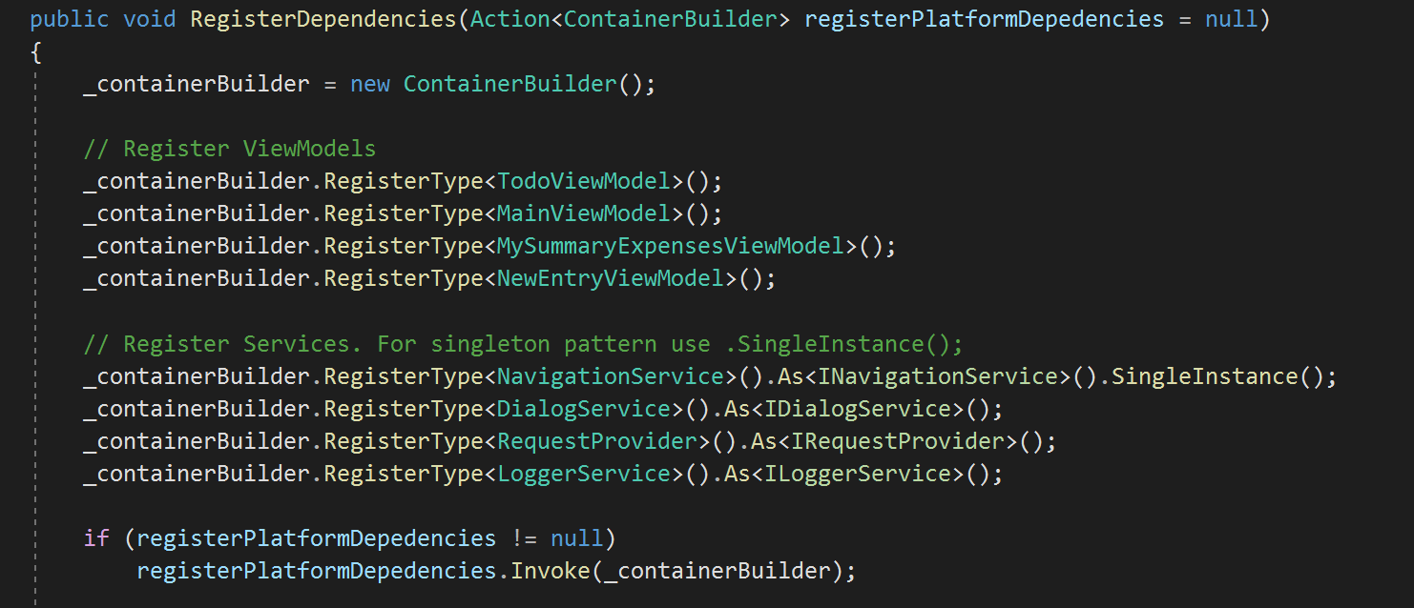
Dependency Service
Notes:
Otra alternativa es Mockear DependencyService
Otra es usar Xamarin.Forms.Mock

Slide 39
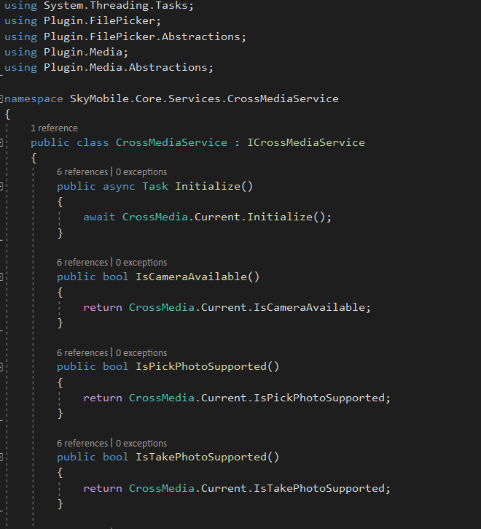
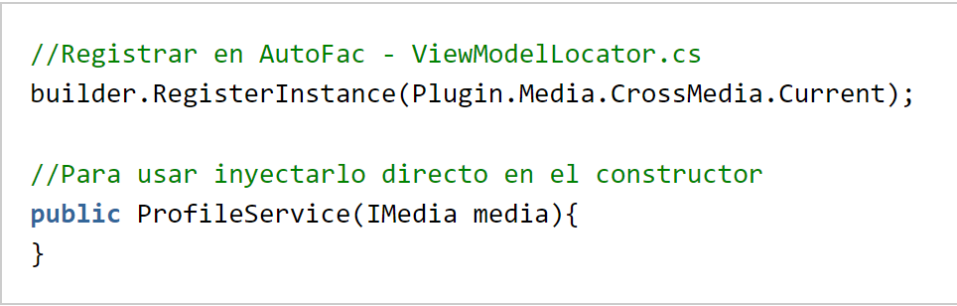
Nuget Plugins
Notes:
En definitiva los plugins externos son interfaces que podemos inyectar

Slide 40
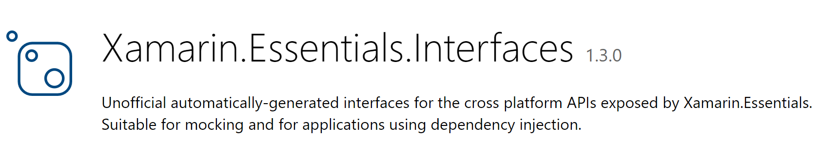
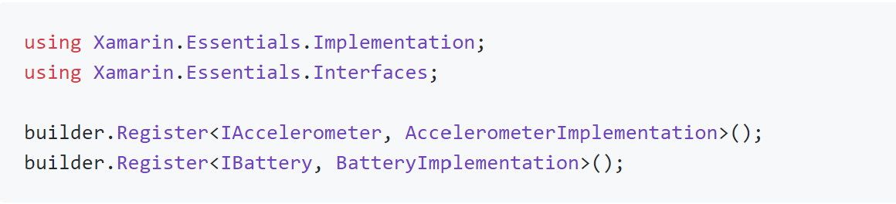
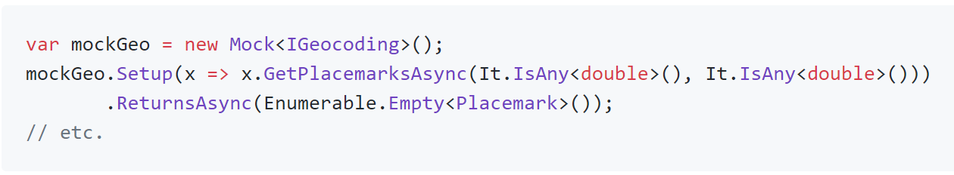
Xamarin Essential
Notes:
essential-interface-generator reads the Xamarin.Essentials source and generates an intermediate model representing the apis exposed by Xamarin.Essentials

Slide 41
Tips
Notes:
Primero tuvimos que preparar nuestro proyecto para que sea testeable

Slide 42
One Bug == One Test
Notes:
La idea no es empezar a crear cientos de test del código que no testie en su momento. Pero si encontramos un bug porque no crear un unittest que lo deje en evidencia para no toparnos con el nuevamente?
Qué testear?
Parametros de la navegación
Propiedes publicas
que sucede luego de un Command

Slide 43
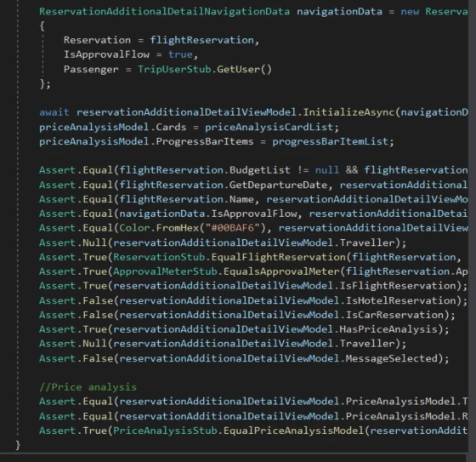
Try to test one thing with each unit test

Slide 44
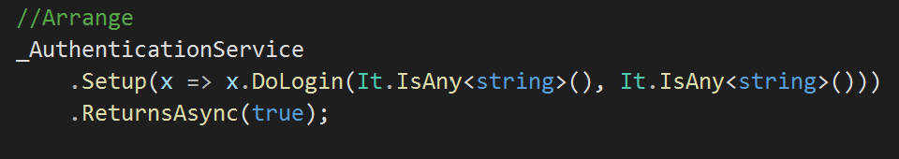
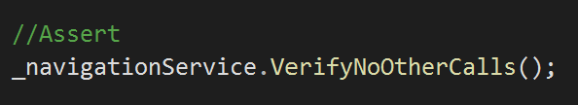
Moq

Slide 45
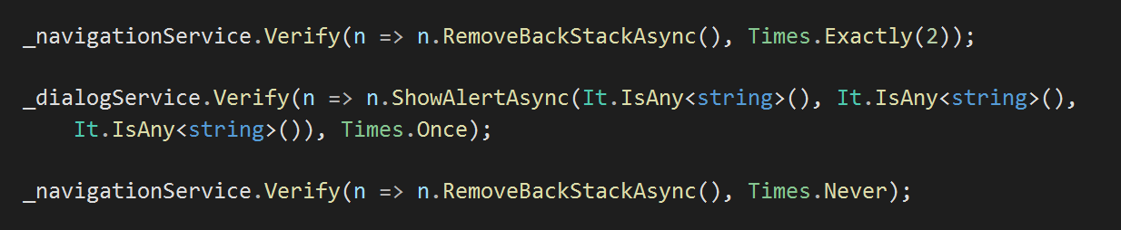
Moq
Times
Navigation with properties

Slide 46
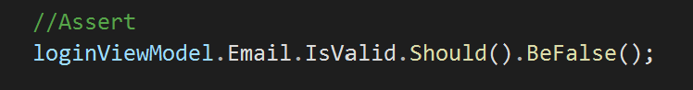
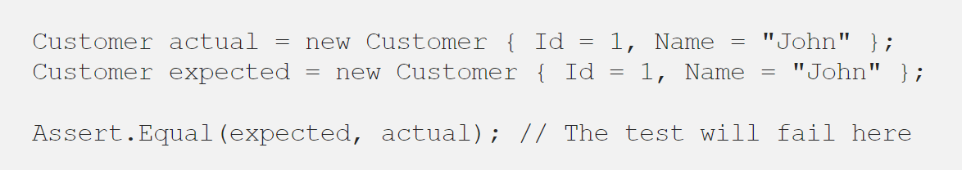
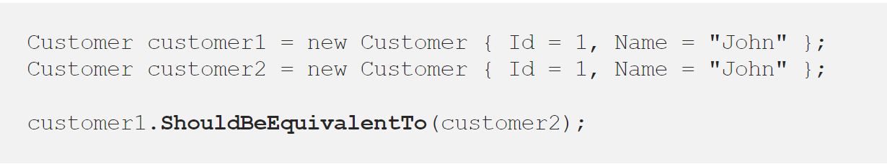
FluentAssertions

Slide 47
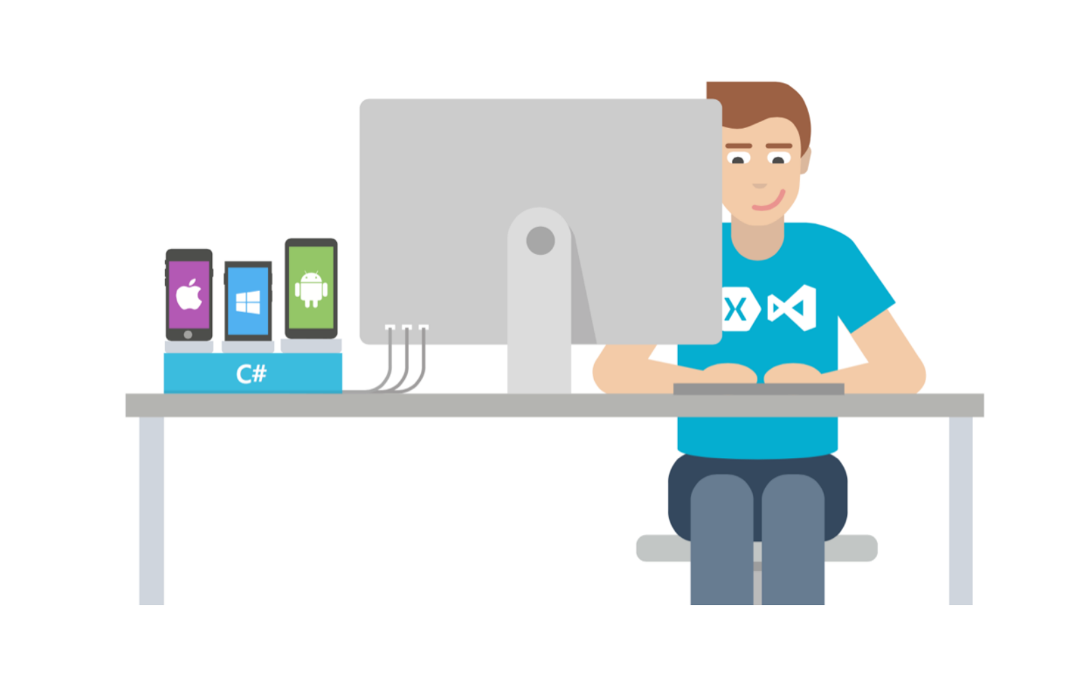
Let’s code

Slide 48
Thank you!

